Slide 1
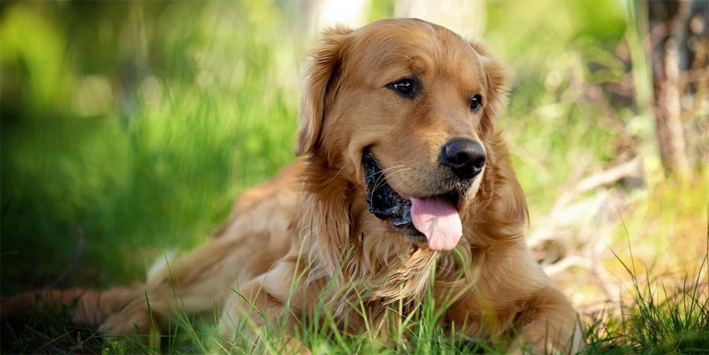
Animal State Prediction
Prepared by:
Ayush Oturkar

Slide 2
PROBLEM STATEMENT
Objective:
To build a machine learning /deep learning model to predict the status of the animals . The goal is to predict the column named “outcome_type”
Description:
The Animal Welfare Center (AWC) is one of the oldest animal shelters in the United States that provide care and shelter to over 15,000 animals each year. To boost its effort to help and care for animals in need, the organization makes available its accumulated data and statistics as part of its Open Data Initiative. The data contains information about the intake and discharge of animals entering the Animal Welfare Center from the beginning of October 2013 to the present day.
The AWC wants to make use of this data to help uncover useful insights that have the potential to save these animals’ lives. To make better decisions in the future regarding animal safety, AWC wants to analyze this data and predict the status of the animals when they leave the welfare center.
Evaluation Metrics:
F1-Score(micro-average)

Slide 3
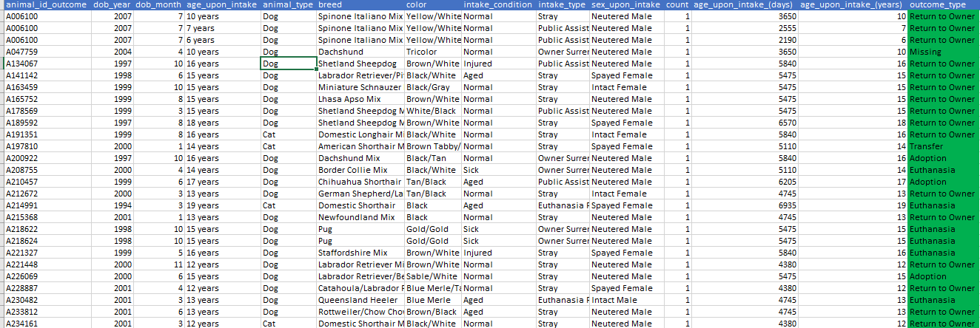
SNAPSHOT OF THE DATASET
Dataset Features:
animal_id_outcome | Unique identifier for each animal
Outcome_type | Eight entries for ex. Adoption, Missing, Euthanasia, Return to Owner, Transfer etc.
Var1 to Var37 | Independent Variables– Numeric, Ordinal and Categorical
This column seems to have same values throughout.
This is the dependent variable

Slide 4


OVERVIEW OF THE MODELING PROCESS
Data Preparation for Modelling
Train Data
Data Exploration
Data Pre-processing
Feature Engineering
Feature Selection
Test Data
Raw Data
ML Algorithms
Test Model
Final Model
Train Data
Model Evaluation
Model Fine Tuning
Adjust the Model Parameters

Slide 5
Quality Checks performed/Error found
Exploratory Data Analysis & Pre-Processing
Key observations/Plots/ Trends
Encoding categorical features
Conversion of dataset into train and validation
Model Selection & Model fitting
Feature Engineering
AGENDA
Retuning
Results & Conclusion

Slide 6
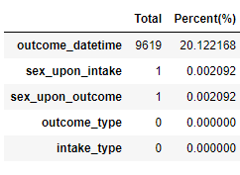
Quality checks performed/Errors
The dependent variable of the training data was found to be unbalanced.
The dataset contains some missing values in it. The missing features in the data are as follows:
More than 20% of the data of outcome_datetime variable is missing
This missing data can be imputed for the analysis purpose.
Note: 15% Missing value is taken as threshold

Slide 7
Quality Checks performed/Error found
Exploratory Data Analysis & Pre-Processing
Key observations/Plots/ Trends
Encoding categorical features
Conversion of dataset into train and validation
Model Selection & Model fitting
Feature Engineering
AGENDA
Retuning
Results & Conclusion

Slide 8
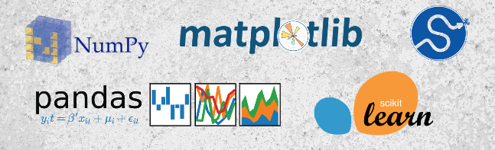
Exploratory Data Analysis & Pre-Processing
Modules Utilized

Slide 9
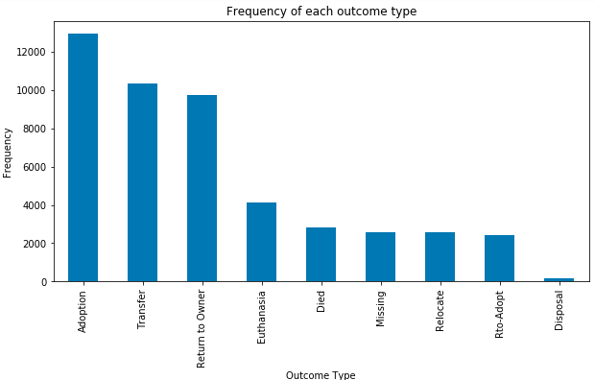
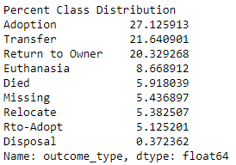
Dependent Variable distribution
From the distribution we can infer around 70% of the animals falls under three class namely Adoption, Transfer, Return to Owner as shown above.

Slide 10
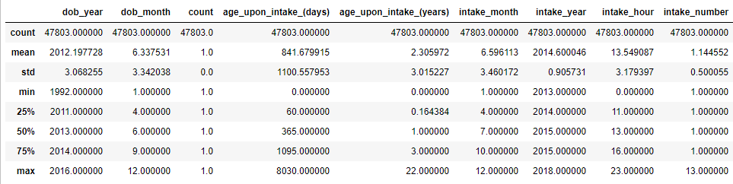
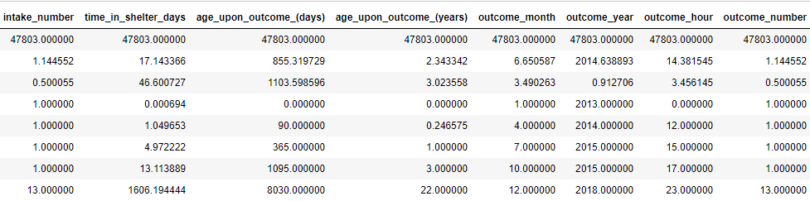
Description of numeric variables
===========================================
Count has std 0, mean, max =1 hence a constant column that we can drop

Slide 11
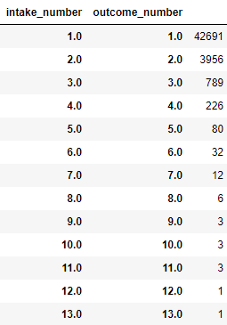
The statistics of "intake_number" and "outcome_number" looks similar hence lets quickly check and take a call.
This is the table showing distinct outcome number corresponding to each unique value of intake number.
This clearly shows both tables are identical.
Hence dropping outcome number and count.

Slide 12
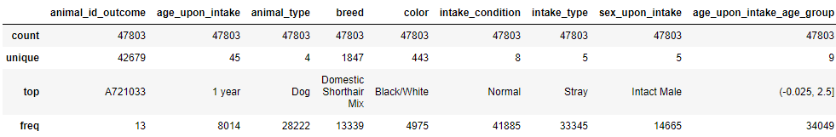
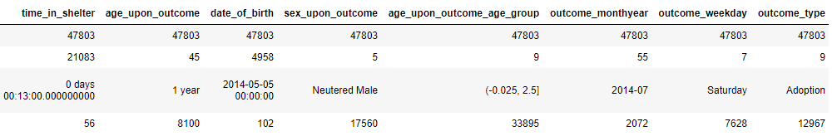
Description of Categorical/ordinal variables
=====================================

Slide 13
VARIABLE ELIMINATION
Variable Name | Reason for dropping
age_upon_intake | Extracted from age_upon_intake hence are correlated with each other. Using age_upon_intake_(years)_days to be more specific.
age_upon_intake_(years)”,
age_upon_intake_age_group
age_upon_outcome | Extracted from age_upon_outcome hence are correlated with each other. Using age_upon_outcome_(years)_days to be more specific.
age_upon_outcome_(years)”,
age_upon_outcome_age_group
date_of_birth | dob_year, dob_month is extracted from date_of_birth hence will be using dob_year and dropping dob and dob_month.
dob_month
time_in_shelter | time_in_shelter_(days) is derived from time_in_shelter hence will be dropping time_in_shelter and keeping time_in_shelter_(days).

Slide 14


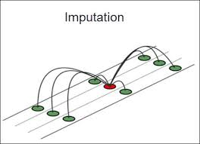
Data cleaning (Missing value imputing, removal of inconsistencies): Categorical Missing values are imputed using Mode and Numeric using mean.
Data Cleaning
Missing Value imputation
Cleaned Data

Slide 15
Quality Checks performed/Error found
Exploratory Data Analysis & Pre-Processing
Key observations/Plots/ Trends
Encoding categorical features
Conversion of dataset into train and validation
Model Selection & Model fitting
Feature Engineering
AGENDA
Retuning
Results & Conclusion

Slide 16
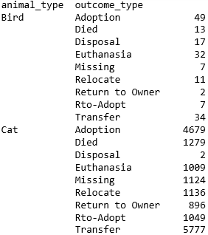
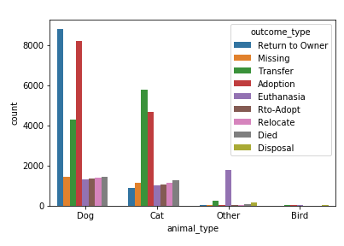
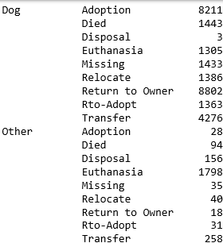
Key Observations/ Trends/ Plots
a) Outcome_type vs animal_type:

Slide 17
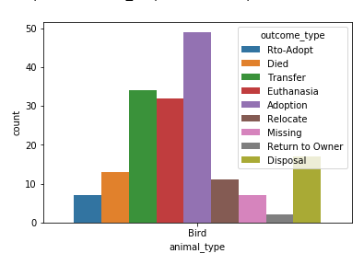
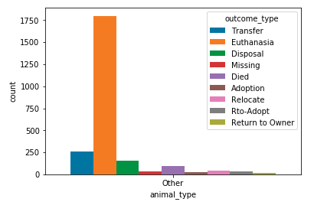
 | Adoption | Transfer | Return to owner | Euthanasia | Died | Missing | Relocate | Rto-Adopt | Disposal
Dog |  |  |  |  |  |  |  |  | 
Cat |  |  |  |  |  |  |  |  | 
Bird |  |  |  |  |  |  |  |  | 
Other |  |  |  |  |  |  |  |  | 

Slide 18
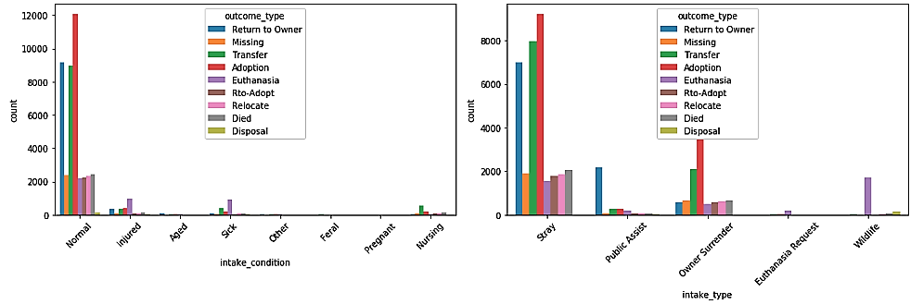
b) Outcome_type vs intake_conditions/intake_type:
Sick and Injured animals are more prone to euthanasia and transfer
Nursing intake animals are transferred mostly.
Public Assist intakes are mostly returned to owner
Wildlife intakes are mostly given euthanasia or are disposed as outcome

Slide 19
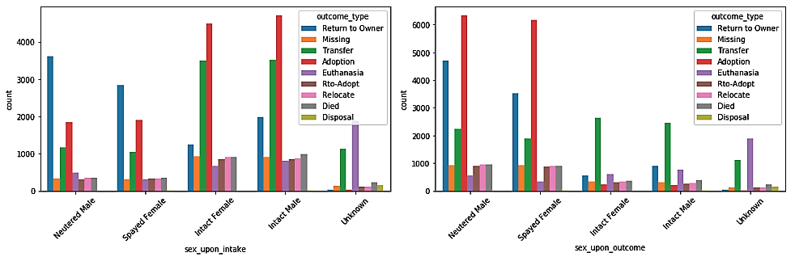
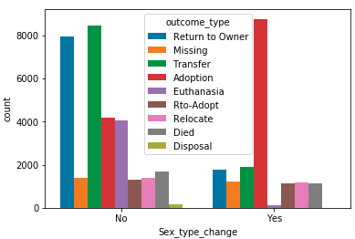
c) Outcome_type vs sex_upon_intake/outcome:
Observations:
Intact male/female who were first intact and later neutered/spayed have more chances of adoption.
Hence an important variable

Slide 20
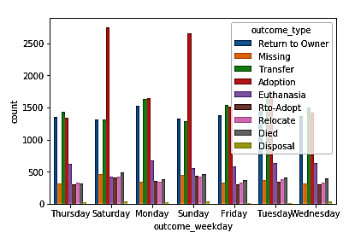

d) Outcome_type vs outcome_weekday:
Observations:
The results are as expected there are relatively more adoptions on Saturday’s and Sunday’s.
Hence can prove to be useful in prediction.

Slide 21
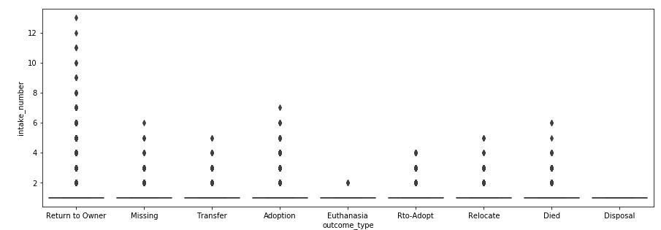
e) Outcome_type vs intake_conditions/intake_type:
Animals with intake number in this range are returned to owner.
Higher number of intake_number has more chances of returning to owner, adoption and missing.
Hence an important variable.

Slide 22
Quality Checks performed/Error found
Exploratory Data Analysis & Pre-Processing
Key observations/Plots/ Trends
Encoding categorical features
Conversion of dataset into train and validation
Model Selection & Model fitting
Feature Engineering
AGENDA
Retuning
Results & Conclusion

Slide 23
Encoding categorical features
Categorical Encoding refers to transforming a categorical feature into one or multiple numeric features
Label Encoding
One-Hot Encoding
Adoptability
adoptable_likely
adoptable_unlikely
Adoptability
1
0
Animal_type
Dog
Cat
Bird
Other
Dog | Cat | Bird | Other
1 | 0 | 0 | 0
0 | 1 | 0 | 0
0 | 0 | 1 | 0
0 | 0 | 0 | 1
Similarly the above transformation is performed over all the other categorical features respectively

Slide 24
Quality Checks performed/Error found
Exploratory Data Analysis & Pre-Processing
Key observations/Plots/ Trends
Encoding categorical features
Conversion of dataset into train and validation
Model Selection & Model fitting
Feature Engineering
AGENDA
Retuning
Results & Conclusion

Slide 25
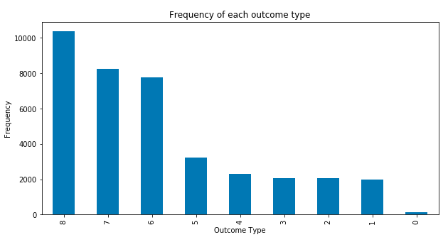

Conversion of dataset into train and validation
Dataset is divided into train and validation set with 80%-20% split to ensure efficient training of model.
Ensured that the distribution of dependent variable in train and validation set is equivalent to that of entire given Train dataset.
Distribution of dependent variable for Train set
Distribution of dependent variable for complete data

Slide 26
Quality Checks performed/Error found
Exploratory Data Analysis & Pre-Processing
Key observations/Plots/ Trends
Encoding categorical features
Conversion of dataset into train and validation
Model Selection & Model fitting
Feature Engineering
AGENDA
Retuning
Results & Conclusion

Slide 27
Model Selection & Model Fitting
Based on the Initial Model Iteration:
Possible Classification models : Logistic Regression, Random Forest, XGBoost, lightGBM Voting Classifier.
Best Personal Model Choice: XGBoost
Reason for selection of XGBoost for initial iteration: Powerful, Efficient, Accurate
Advantages of XGBoost:
Regularization
Parallel Processing
Built in cross-validation
Excellent performance on imbalanced data
Feature scaling not required
Apart from this we will be comparing the performance of XGBoost Model with other models.

Slide 28
Parameters of XGBoost:
General Parameters
a) Booster = gbtree, gblinear
b) nthread = no. of core
2) Boosting Parameters
a) eta/learning rate= Good Range: 0.01 – 0.2
b) min_child_weight= Default:1
c) max_depth = Max depth of decision tree (Typical range:3-10)
d) max_leaf_node= Max no. of terminal nodes
e) Gamma= Specifies min loss reduction(Default=0)
f) Subsample = Good range: 0.5-1
g) lambda= L1 regularization term
h) alpha= L2 regularization terms
i) n_estimator = No. of boosted tree to fit
3) Learning Task Parameters
Objective= Type of dependent variable
prediction. Ex.- binary:logistic,
multi:softmax, multi:softprob etc.
Eval_metric= Type of evaluation metric
Ex.= mlogloss etc.

Slide 29
Model Performances:
S. No. | Model Name | F1-Score Validation | F1-Score Test
1. | Logistic Regression | 57.03 | 50.07
2. | Random Forest | 60.4 | 56.67
3 | lightGBM | 64.29 | 59.99
4. | XgBoost | 64.5 | 61.03
Hence XGBoost & lightGBM outperformed other model in initial iteration.

Slide 30
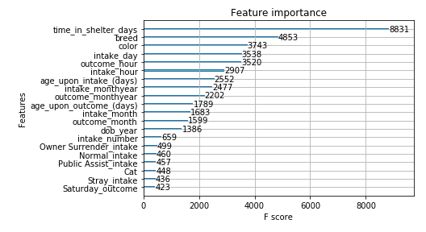
Feature importance curve(Initial):
Breed and color are label encoded just for baseline model fitting and performance check*
Needs to be bucketed.
Variable proving hypothesis of being an important estimator.

Slide 31
Quality Checks performed/Error found
Exploratory Data Analysis & Pre-Processing
Key observations/Plots/ Trends
Encoding categorical features
Conversion of dataset into train and validation
Model Selection & Model fitting
Feature Engineering
AGENDA
Retuning
Results & Conclusion

Slide 32

Feature Engineering
Feature engineering is the process of using domain knowledge of the data to create features that make machine learning algorithms work more effectively.
S No. | Feature Generated | Description
1. | Intake_day | Intake day is the day part which is extracted from intake_datetime
2. | breed_bucket | This is a feature build to bucket the breed feature which has more than 1200 unique breed.
3. | adoptability | From past history of animals adoptability is distributed into two parts adoptable_likely and adoptable unlikely.
4. | disposability | From past history of animals disposability is distributed into two parts high_disposability and low_disposability.
5. | rto_adoptability | From past history of animals adoptability is distributed into two parts rto_adoptable_likely and rto_adoptable unlikely.

Slide 33
Quality Checks performed/Error found
Exploratory Data Analysis & Pre-Processing
Key observations/Plots/ Trends
Encoding categorical features
Conversion of dataset into train and validation
Model Selection & Model fitting
Feature Engineering
AGENDA
Retuning
Results & Conclusion

Slide 34
Model Retuning
S. No. | Model Name | F1-Score(I) (Validation) | F1-Score(F) (Validation) | F1-Score(I) (Test) | F1-Score(I) (Test)
1. | Logistic Regression | 57.03 | 58.30 | 50.07 | 54.98
2. | Random Forest | 60.4 | 62.45 | 56.67 | 59.29
3 | lightGBM | 64.29 | 64.41 | 59.99 | 62.37
4. | XgBoost | 64.48 | 64.50 | 61.03 | 62.44
5. | Voting Classifier | NA | 64.88 | NA | 63.67

Slide 35



Voting Classifier
A Voting Classifier model combines multiple different models (i.e., sub-estimators) into a single model to generate a ensemble of models.
Next Steps
Xgboost
W1
Ensemble
Voting
Random Forest
W2
Ensemble
Data Input
Predictions
W3
lightGBM

Slide 36
Comparison between weights:
Xgboost (W1) | Random Forest (W2) | lightGBM (W3) | F1-Score(Validation) | F1-Score(Test)
1 | 1 | 1 | 64.52 | 61.33
2 | 1 | 2 | 64.88 | 63.67
2 | 1 | 1 | 64.58 | 61.87
3 | 1 | 2 | 64.60 | 63.01
Best classifier

Slide 37
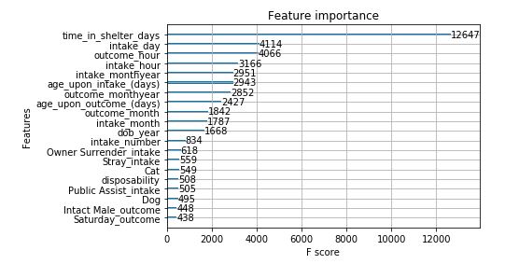
Feature Importance curve

Slide 38
Quality Checks performed/Error found
Exploratory Data Analysis & Pre-Processing
Key observations/Plots/ Trends
Encoding categorical features
Conversion of dataset into train and validation
Model Selection & Model fitting
Feature Engineering
AGENDA
Retuning
Results & Conclusion

Slide 39
Results
Classification Report of the final Voting Classifier Model:
Errors Noted:
Model is not able to predict Relocate and Missing outcome properly.
Note: Model tuned and reiterated in such a way to have decent prediction on the minority class such as “Disposal”

Slide 40
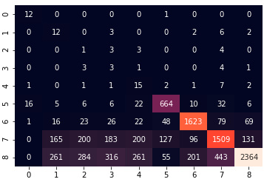
Confusion Metrics for final model
Predicted
Actual

Slide 41

Conclusion
Most significant variables: “time_in_shelter_days”, “intake_day”, “intake_number”,
“age_upon_intake_days”, ”age_upon_outcome_days” .
Evaluation: F1-score of 64.88 on the validation set and 63.67 on the test set which is a decent score.
Cross Validation accuracy table:
Validation Size | F1-Micro (mean) | Std Deviation
5 | 0.648 | +/- 0.01
10 | 0.647 | +/- 0.01
15 | 0.645 | +/- 0.01
20 | 0.644 | +/- 0.01
Error: Expected error = 0.35(Approx) +/- 0.01

Slide 42


